Slide 1
Subject Selection – Year 10 2022
SUBJECT SELECTION
YEAR 10
2022
- PRESENTER -
Mrs Rachael Turnbull – Head of 7-12 Curriculum (Students)
r.turnbull@stpeters.qld.edu.au
Challenging Minds, Nurturing Hearts, Building Futures

Slide 2
Subject Selection – Year 10 2022
Start of Senior School
INCREASED
CHOICES
INCREASED EXPECTATIONS
ACADEMIC JOURNEY
INDEPENDENCE JOURNEY
Challenging Minds, Nurturing Hearts, Building Futures

Slide 3
Subject Selection – Year 10 2022
COMPULSORY SUBJECTS
English | Whole year (at a level assigned by the Curriculum Leader based on demonstrated competencies and consultation with parents.)
Mathematics | Whole Year (at a level assigned by the Curriculum Leader based on demonstrated competencies and consultation with parents.)
Science | Whole Year
Health and Physical Education / The Rite Journey | Whole Year – (HPE 7 lessons per cycle: TRJ 2 Lessons per cycle)
Religion and Ethics * | One Semester
Humanities – History | One Semester
All Year 10’s will study these subjects
Challenging Minds, Nurturing Hearts, Building Futures

Slide 4
Subject Selection – Year 10 2022
IMPORTANT NOTE: Religion and Ethics
Year 10 – Units 1 & 2
The start of Senior Subjects that can count towards a student’s QCE
Students need to pass each Unit to gain credit towards their QCE
Challenging Minds, Nurturing Hearts, Building Futures

Slide 5
Subject Selection – Year 10 2022
COMPULSORY | ELECTIVES
ENGLISH (Enrichment, Mainstream, Essentials) MATHEMATICS (Advanced, General) SCIENCE SOSE – HISTORY CORE HPE RELIGION & ETHICS | ARTS | BUSINESS | HPE | LOTE
 | Drama Media Music Visual Art | Finance Justice Studies Entrepreneurial Studies | Introduction to PE | Chinese French German Japanese
 | SCIENCE | HUMANITIES | SPECIALIST SUPPORT | TECHNOLOGY
 | Psychology | Geography | ASDP EAL | Digital Technology Design and Technology Fashion Studies Food Studies Graphics and Design
Challenging Minds, Nurturing Hearts, Building Futures

Slide 6
Subject Selection – Year 10 2022
COMPULSORY | ELECTIVES
ENGLISH (Enrichment, Mainstream, Essential) MATHEMATICS (Advanced, General) SCIENCE SOSE – HISTORY CORE HPE RELIGION & ETHICS | ARTS | BUSINESS | HPE | LOTE
 | Drama Media Music Visual Art | Finance Justice Studies Entrepreneurial Studies | Introduction to PE | Chinese French German Japanese
 | SCIENCE | HUMANITIES | SPECIALIST SUPPORT | TECHNOLOGY
 | Psychology | Geography | ASDP EAL | Digital Technology Design and Technology Fashion Studies Food Studies Graphics and Design
Students will select six (6) semester units and be allocated four (4) semester units from this list. NOTE: Languages and Specialist support subjects count for TWO units
Challenging Minds, Nurturing Hearts, Building Futures

Slide 7
Subject Selection – Year 10 2022
Guidelines for parents and students
In making decisions about subject selection it is important for students to choose subjects:
• that they enjoy – you are more likely to do well in subjects you like;
• in which you are successful. Coupled closely with these is your diligence and application to your previous studies in the various subjects;
• that suit your interests and skills.
Challenging Minds, Nurturing Hearts, Building Futures

Slide 8
Subject Selection – Year 10 2022
In making decisions about subject selection It is unwise to take or avoid a subject because:
• someone told you that you will like or dislike it;
• you hope your friends will be in the same class – there may be several classes of a subject;
• you expect a certain teacher to be teaching the subject.
Challenging Minds, Nurturing Hearts, Building Futures

Slide 9
Subject Selection – Year 10 2022
It is important to find out as much as possible about the subjects offered by:
talking to teachers and Curriculum Leaders;
attending information talks and subject selection evenings- tick!;
investigating career and employment opportunities – visit the Career Centre (top level of Theile House);
talking to students who are already studying the subject
reading the Course Planning Guide
Challenging Minds, Nurturing Hearts, Building Futures

Slide 10
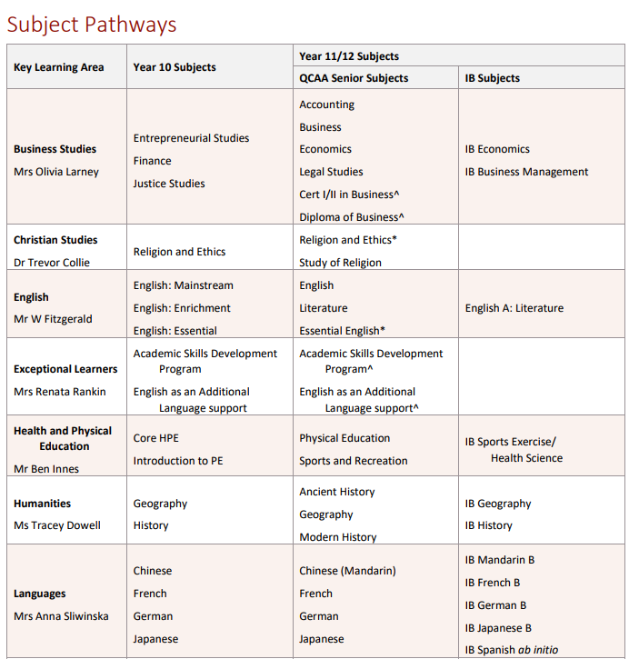
Subject Selection – Year 10 2022
Course Planning Guide
This can give students/parents and idea of pathways.
Subject Pathways in the Course Planning Guide:
https://stpeters.fireflycloud.net.au/academic-operations/course-planning-guides
Challenging Minds, Nurturing Hearts, Building Futures

Slide 11
Subject Selection – Year 10 2022
Course Planning Guide – Subject Descriptors
Read the subject overview to see what the program contains and where it can lead.
Challenging Minds, Nurturing Hearts, Building Futures

Slide 12
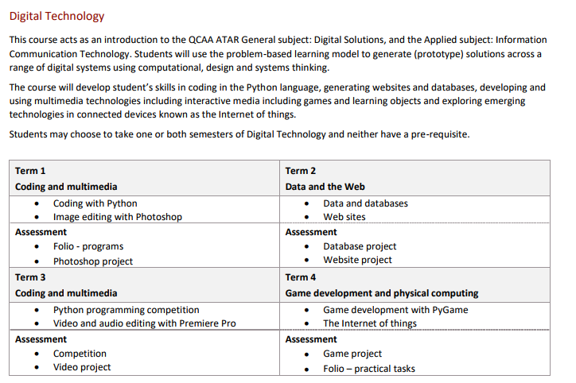
Subject Selection – Year 10 2022
Course Planning Guide – Subject Descriptors
TASKS: Look at the types of tasks and identify if this interests you.
Challenging Minds, Nurturing Hearts, Building Futures

Slide 13
Subject Selection – Year 10 2022
Course Planning Guide – Subject Descriptors
TASKS: Look at the types of tasks and identify if this interests you.
ASSESSMENT: Look at the types of assessment you might be doing.
Challenging Minds, Nurturing Hearts, Building Futures

Slide 14
Subject Selection – Year 10 2022
CONSIDERATIONS:
Prerequisites and Pathways
Maths Level
English Level
Language
Music
Challenging Minds, Nurturing Hearts, Building Futures

Slide 15
Subject Selection – Year 10 2022
You have received an email containing:
‘Select My Subject’ Access Guide (which details your individual Student Access Code, password, and instructions on how to complete your subject preferences online)
The ‘Select My Subject’ Access Guide is required in order to complete the subject selection process for 2022.
Subject Selection Procedures
Challenging Minds, Nurturing Hearts, Building Futures

Slide 16
Subject Selection – Year 10 2022
Students are to nominate SIX (6) preferences, of which FOUR (4) will be allocated, based on availability.
Languages, EAL and ASDP each count as TWO semester electives - as they run for the whole year. If selected, they must go in as Preference 1,2,3 or 4
Complete online subject selections
(Requires individual Student Access Code + Password)
OPENS 5pm FRIDAY 23rd July
CLOSES 9am, Monday 2nd August
Challenging Minds, Nurturing Hearts, Building Futures

Slide 17
Subject Selection – Year 10 2022
Web Preferences
Challenging Minds, Nurturing Hearts, Building Futures

Slide 18
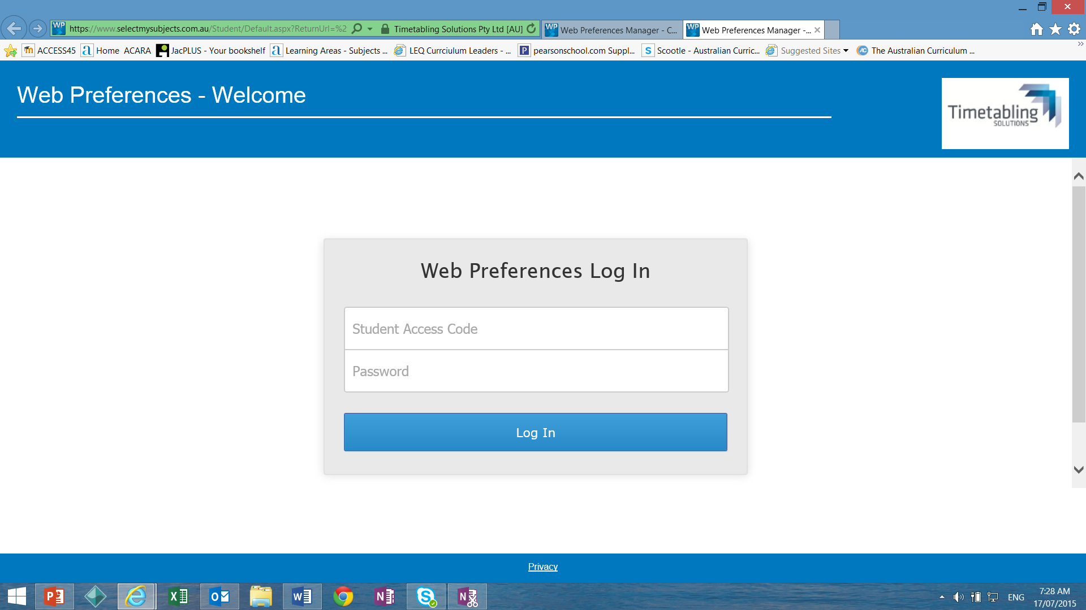
Subject Selection – Year 10 2022
Step 1 – logon to: webpreferences
WEB PREFERENCES OPENS:
5pm Friday 23rd July
Challenging Minds, Nurturing Hearts, Building Futures

Slide 19
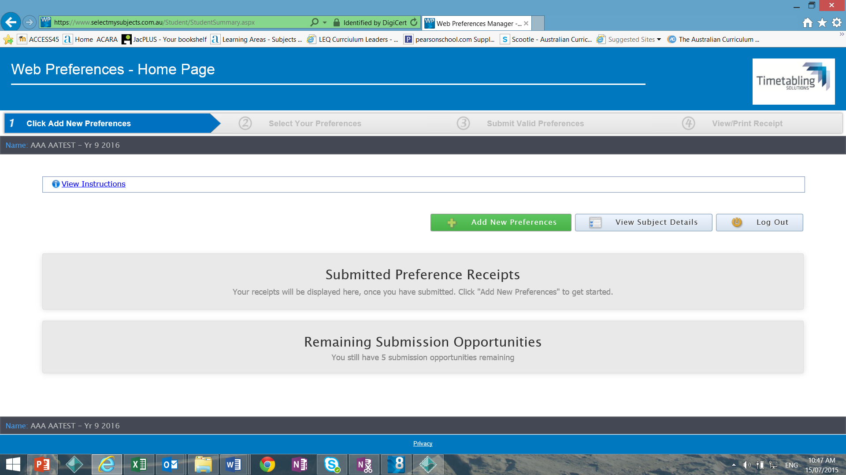
Subject Selection – Year 10 2022
Click Add new Preferences
Step 2 – click: Click add new preferences
Challenging Minds, Nurturing Hearts, Building Futures

Slide 20
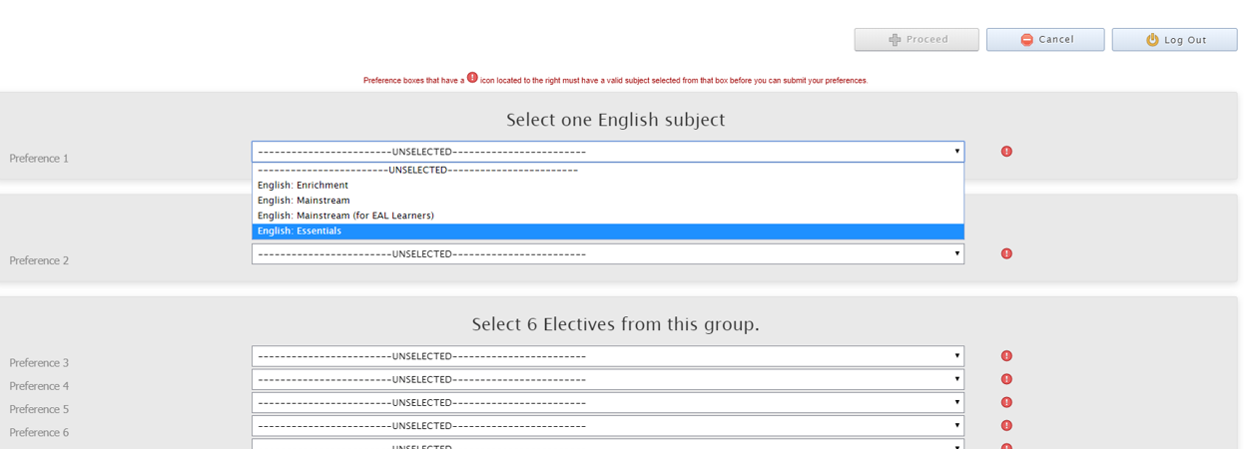
Subject Selection – Year 10 2022
Preference #1 will be English. Choose form the drop down menu which level (Enrichment, Mainstream, Essentials, EAL)
Challenging Minds, Nurturing Hearts, Building Futures

Slide 21
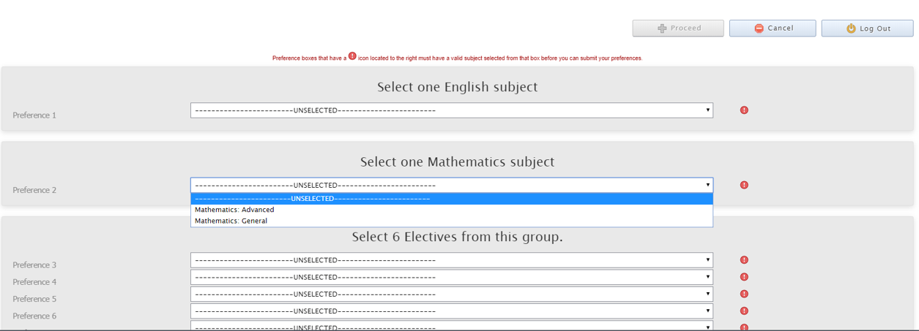
Subject Selection – Year 10 2022
Preference #2 will be Mathematics. Choose form the drop down menu which level (Advanced or General)
Challenging Minds, Nurturing Hearts, Building Futures

Slide 22
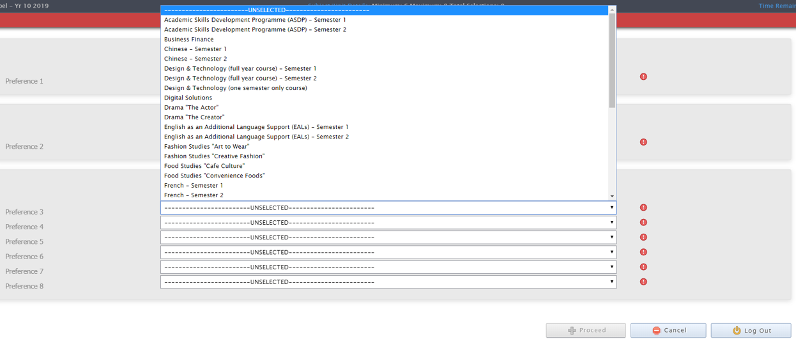
Subject Selection – Year 10 2022
Preference #3 through to #6 will be your electives choices. Choose form the drop down menu
Challenging Minds, Nurturing Hearts, Building Futures

Slide 23
Subject Selection – Year 10 2022
Preference #3 through to #6 will be your electives choices. Choose form the drop down menu
Preferences #7 and #8 will be used if the previous preferences cannot be allocated
Challenging Minds, Nurturing Hearts, Building Futures

Slide 24
Subject Selection – Year 10 2022
Web Preferences – Student example
Challenging Minds, Nurturing Hearts, Building Futures

Slide 25
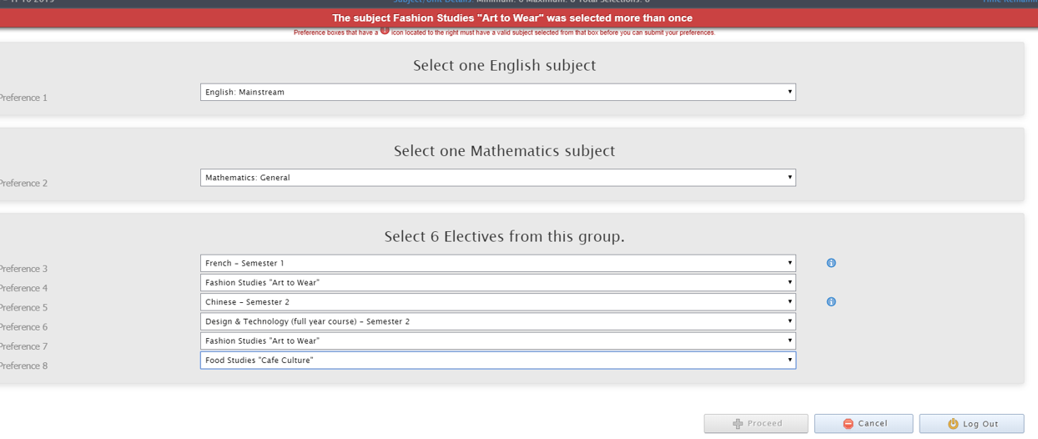
Subject Selection – Year 10 2022
Fashion “Art to Wear” has been selected twice
French is a full year subject and will need to be selected for both semesters
Challenging Minds, Nurturing Hearts, Building Futures

Slide 26
Subject Selection – Year 10 2022
Fashion “Art to Wear” has been selected twice
French is a full year subject and will need to be selected for both semesters
If there are errors, the proceed button will not be available
Challenging Minds, Nurturing Hearts, Building Futures

Slide 27
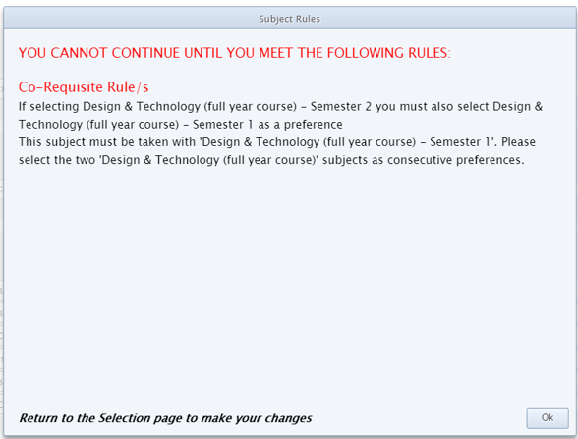
Subject Selection – Year 10 2022
An ALERT pop up
will notify you if the combination of subjects you select, do not meet co-requisite rules
Challenging Minds, Nurturing Hearts, Building Futures

Slide 28
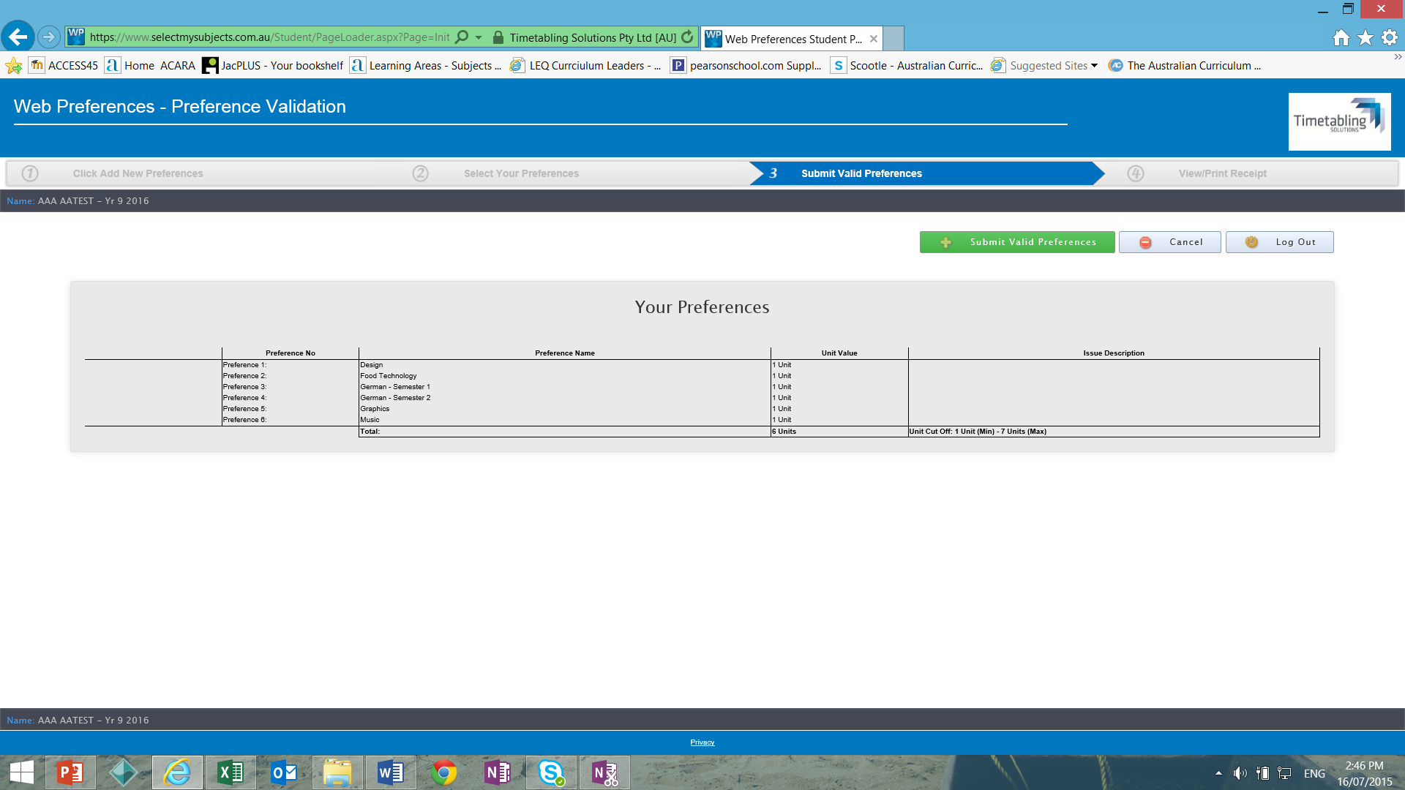
Subject Selection – Year 10 2022
Step 4: Submit valid Preferences
Challenging Minds, Nurturing Hearts, Building Futures

Slide 29
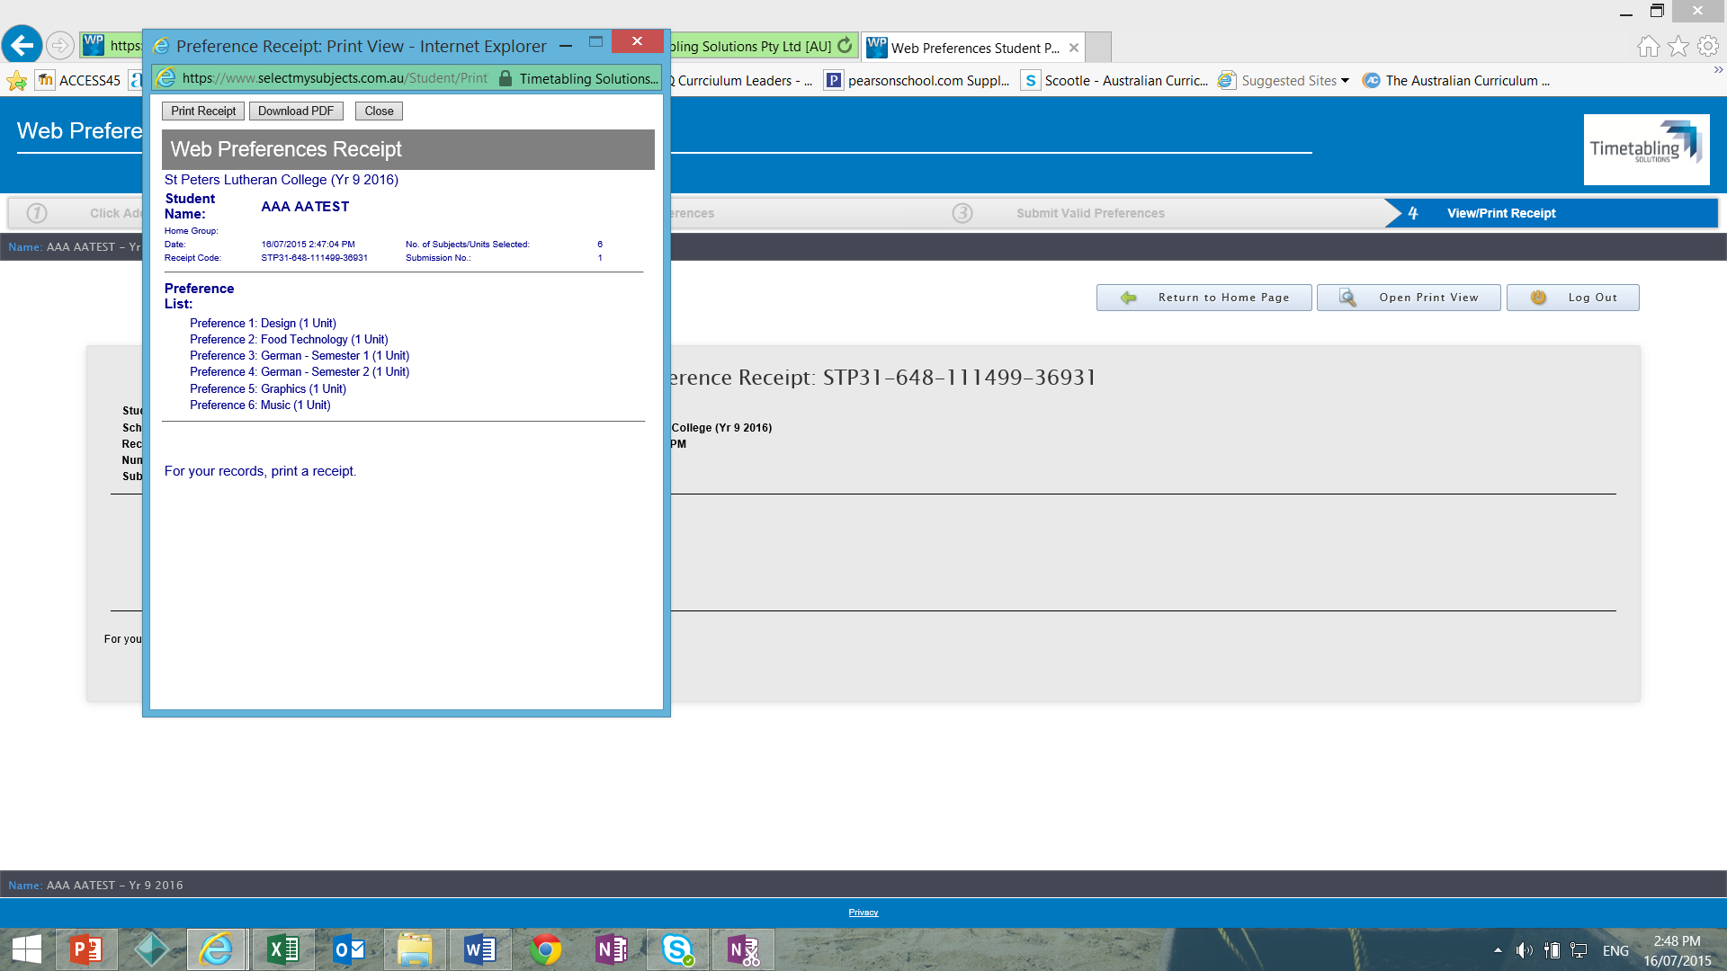
Subject Selection – Year 10 2022
Step 5: View/Print Receipt
Challenging Minds, Nurturing Hearts, Building Futures

Slide 30
Subject Selection – Year 10 2022
Step 6: Logout
FINAL Step: Bring printed, signed receipt to your Form Class teacher by Tuesday 3rd August
Challenging Minds, Nurturing Hearts, Building Futures

Slide 31
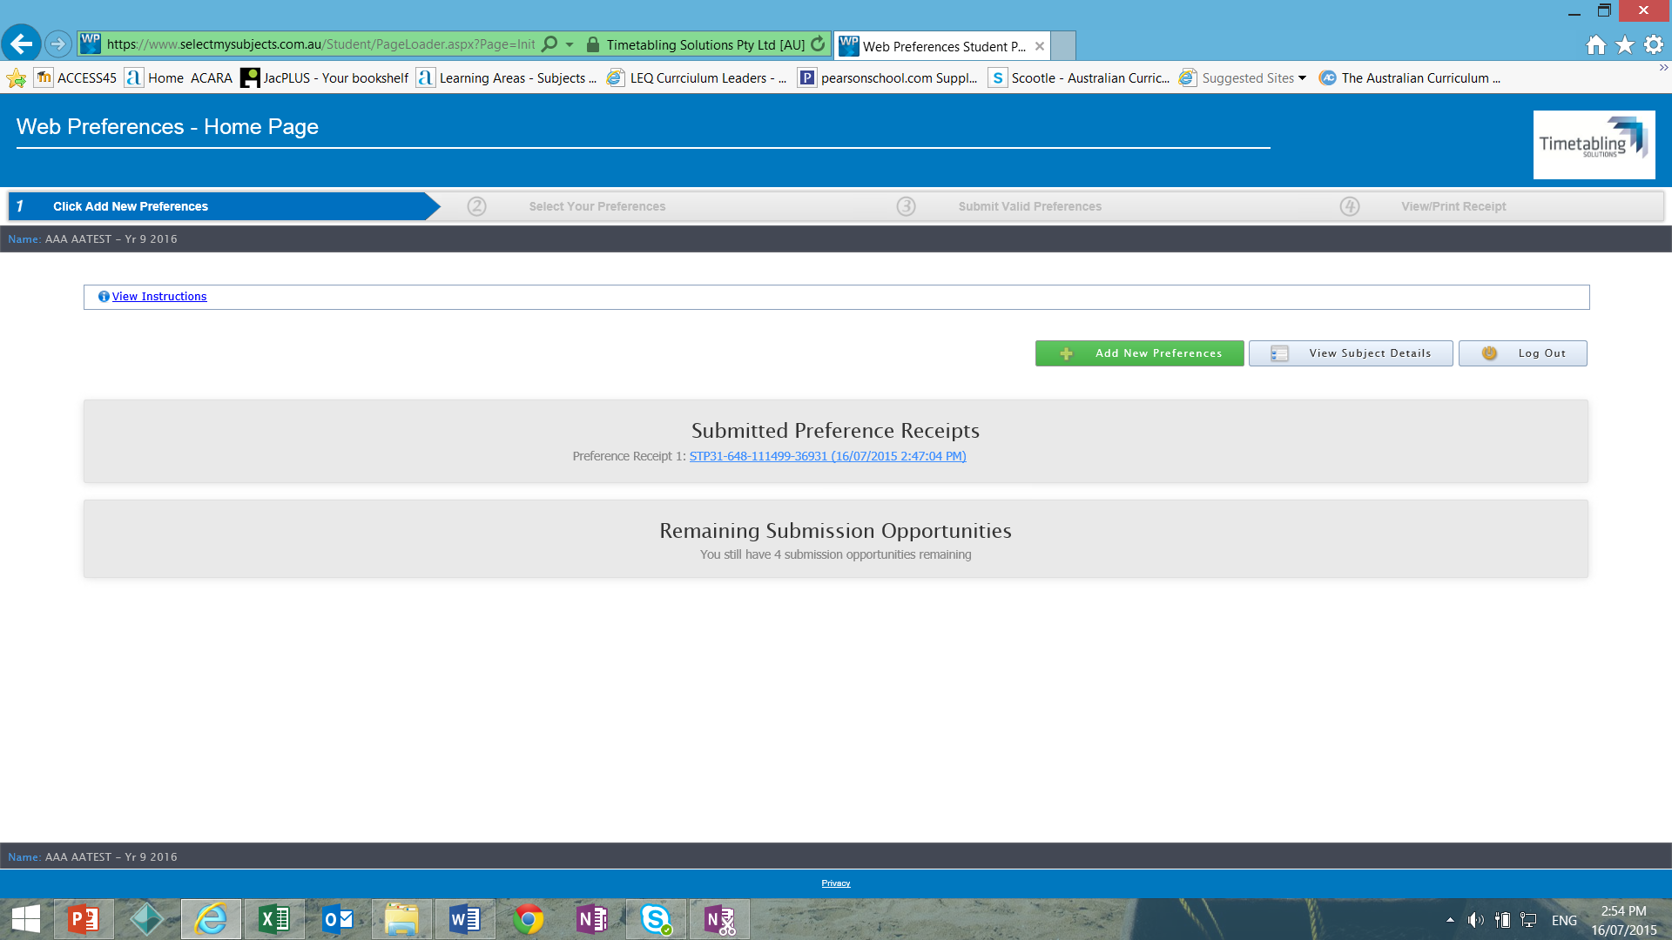
Subject Selection – Year 10 2022
Changing your Preferences:
Simply login in and go through the process again. Click Add New Preferences
Challenging Minds, Nurturing Hearts, Building Futures

Slide 32
Subject Selection – Year 10 2022
WEB PREFERENCES EMAIL: Thursday 22nd July
SUBJECT SELECTION OPENS: Friday 23rd July 5pm
SUBJECT SELECTION CLOSES:
Monday 2nd August 9am
Challenging Minds, Nurturing Hearts, Building Futures

Slide 33
Subject Selection – Year 10 2022
Common Questions
Can a student change subject during the year?
Does a student need to know NOW what pathway they will take?
Challenging Minds, Nurturing Hearts, Building Futures

Slide 34
Subject Selection – Year 10 2022
Final Thoughts……
Developing good study habits now
Study time – 10 minutes per year level (e.g. Year 9’s now should be about 90 mins per night)
Organisation is vital
Check attitudinal grades, teacher feedback and GPA graphs for trends
BALANCE IS KEY
Challenging Minds, Nurturing Hearts, Building Futures

Slide 35
Subject Selection – Year 10 2022
Contact Information –
Mrs Rachael Turnbull – Head of 7-12 Curriculum (Students)
r.turnbull@stpeters.qld.edu.au
Academic Operations – a.operations@stpeters.qld.edu.au
Challenging Minds, Nurturing Hearts, Building Futures

